Slide 1
Benjamin Tisinger Process Improvement Final Project
MBC 638

Slide 2
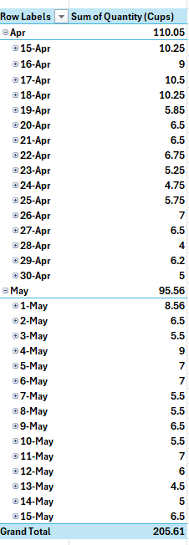

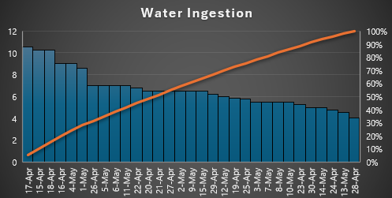

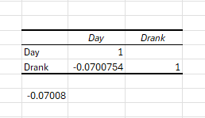
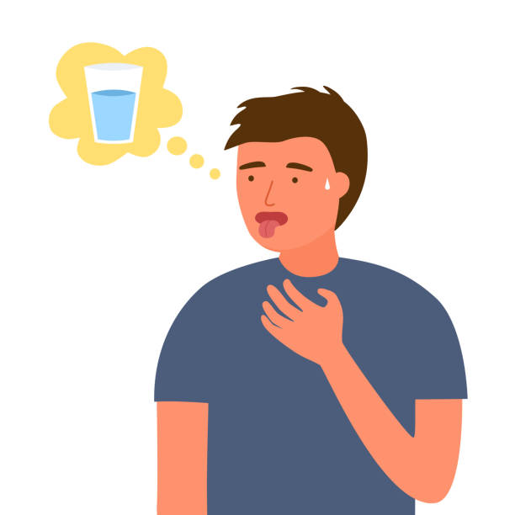
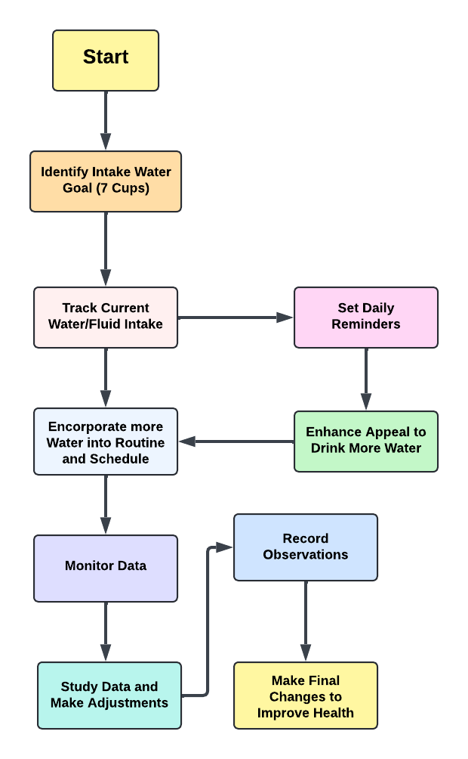
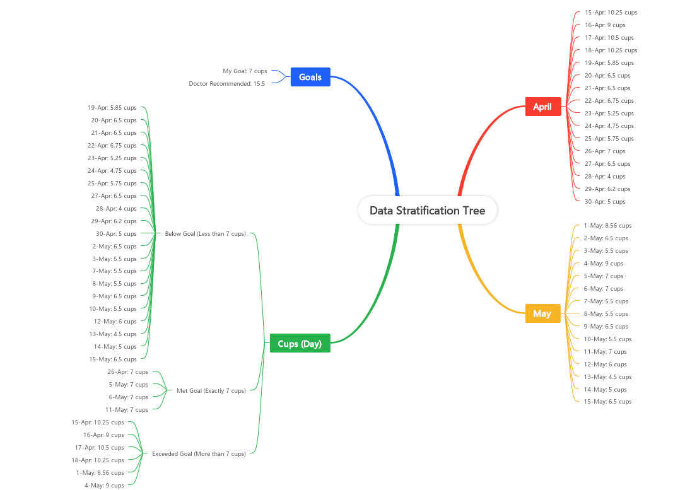
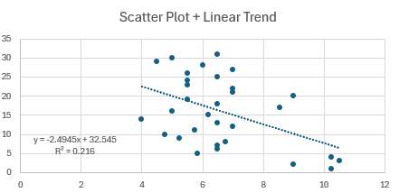
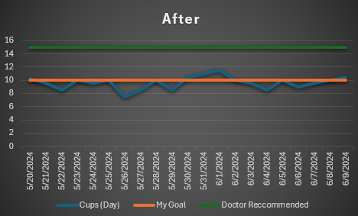
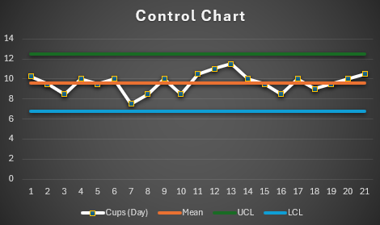
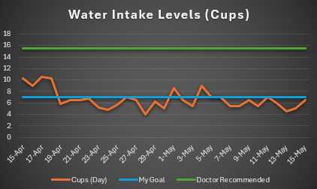
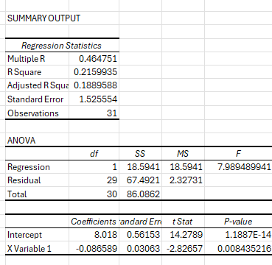
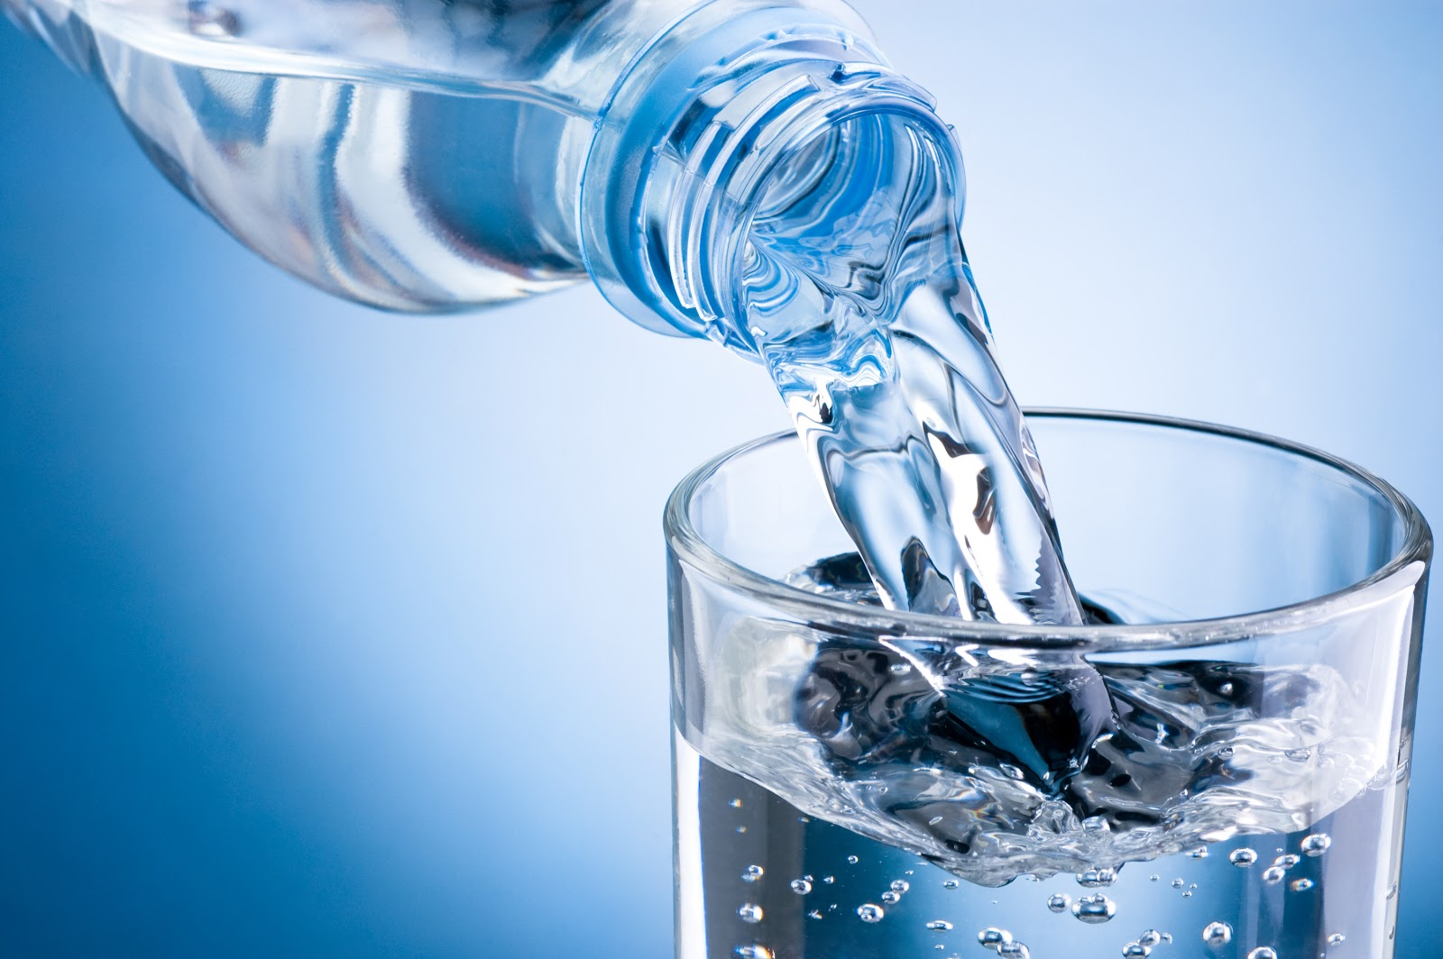
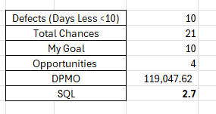
Key Indicators:
Start Date
04/08
Define
Measure
Analyze
Improve
Control
4/10
4/15 to 5/15
5/6 to 5/17
5/20 to 5/31
6/1 to 6/7
Define
Measure
Analyze
Improve
Problem Statement:
I am facing a daily challenge with maintaining proper fluid intake, leading to issues like lack of focus, headaches, dizziness, and general discomfort. Medical tests and doctor visits have shown that drinking more water could improve my overall health. By increasing my fluid intake, I believe I can enhance my well-being and address symptoms of dehydration , exhaustion and fatigue.
SQL
= 2.7!
Mean is Close to Target Goal (7)
SQL Increased from
2.4 to 2.7!
Problem :
While water is being ingested, we can see that over one moth of data there were 22 days of Defects. IE…73.33% of the time I failed to reach my 7 Cups Target.
Solution:
Introduce ways to be more proactive about drinking fluids. Maybe use Smells or flavored water solutions. Read and study data to see which days could use most improvement.
Improvement:
I ran a correlation test on the correlation between which days of the week and amount of water ingested.
With the Value of -0.0700 we can infer that as days increase throughout the week, we drink less fluids.
Can we Improve our Intake?
How do we make water more enticing?
Improvement:
We made a huge Improvement! Decreasing our total number of Defects to 10!
Decreased our Errors from 73.3% to 47.61%
Control
SQL
= 2.4
Main Control and Stick to plan of Heavy Cups at the start and end of a week to Continue Improvement
Benjamin Tisinger

Slide 3
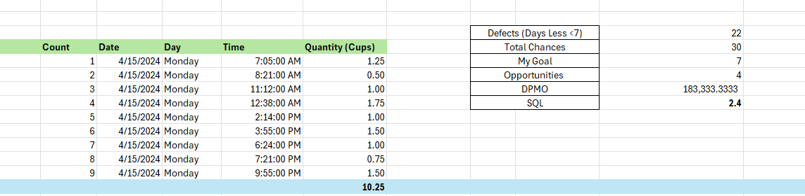
Define
What was our Goal?
Our Goal for this improvement project was to see a difference in the amount of water ingested. I think over the course of the next few slides you will be able to see an increase in the number of fluids ingested.
The best way to determine if we are known to have a successful experience would just to see an increase in the number of fluids ingested. During the first course of the project, I focused on reaching the goal of 7 Cups a day with earlier predictions thinking I was drinking around 5 cups a day.
Operational Definitions
SQL Calculation for Original Data – Showing 2.4
Descriptive Statistics
Confidence Level
Day – 24 Hour Period of Data Record Time – 12:00am to 11:59 PM
Quantity of Water – Total Volume of Water ingested for a particular event (My Data has Recorded multiple times a day and the overall sum of water per day) Recorded in Cups
Water Sources – Only Recording Water – Defects would be alternatives such as Tea, Coffee, Juice and Soda.
Ingestion Event – Recording Time of Water Ingestion during the Day
Recording Method – Done on Excel and Excel Mobile
Water Exclusions – Didn’t record water used for other sources like Cooking or unknown sources
Mean of 6.63 Cups of Water Per Day
Standard Error of 0.3042
Median of 6.5
Mode of 6.5
Standard Deviation of 1.69
Minimum of 4
Maximum of 10.5
Recorded Observations to 31
Upper Confidence Limit of 7.25
Lower Confidence Limit of 6.011
Process Improvement
During this Improvement Project, I want to improve the most on defaulting to water instead of other drinks. I also want to really focus on following through with drinking more larger quantities of water in multiple sittings.
Current Steps of the Process:
Identify Goals
Track Intake
Reminders
Appeal more to Drinking
Monitor Data
Record and Analyze
Adjust
Make Final Changes and Lifestyle Improvements
Updated Process Map for Water Recording

Slide 4
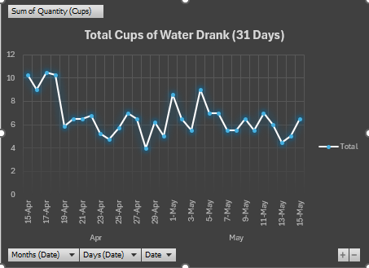
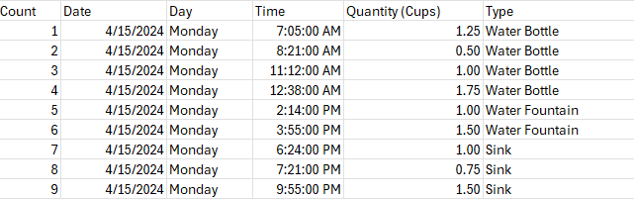
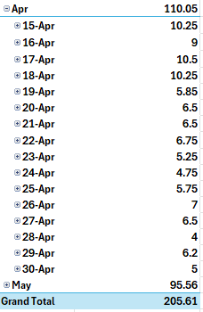
Measure
Larger View of my Original Data Stratification Tree
Types of Data Recorded:
Date – Date of Event (Day)
Time of Day – Recorded Each Time
Cups of Water – Quantity
Day Number (1-7) Coordinating for Regressions and Correlation
Pivot Tables to Show Table options relating to Filtering on Type of Day, Time and Count
Types of Water such as Bottled/Tap or Just ETC… Like a Gatorade or Body Armor Infusion Drinks based on Water
Data Collection:
I collected all my Data on my own throughout multiple days, hours and weeks from April 15th, 2024, to May 15th, 2024
I overall Collected 172 different occurrences of water being drank during that timeline from April to May
Most of my regressions, calculations and other models were ran using shortened data focusing on the daily Totals drank
I believe it was an ideal sample size because I got to look at the daily data stretched out over time and look at the specific data focused on daily sums
I believe collecting fewer samples would not have given me the insight needed to see how a lot of water was being ingested at the start of the weeks but progressively slowed down towards the end of the week.
Measurement Error could have been recorded during the phase of checking on times. There may have been a couple of occurrences where you drink water and quickly write down how much you drank but may have not focused on the exact time of day.
Data Continuous or Discrete?:
I believe that my data is on the Continuous Side
The quantity of data could be measured
There is no Fixed Limit on how much could’ve been recorded
The data can be sliced and diced and measured properly
Quick Screenshot of Data Records
Pivot Chart

Slide 5
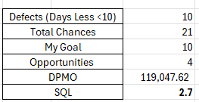
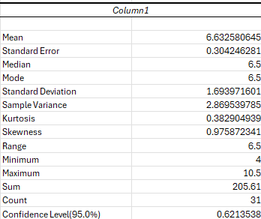
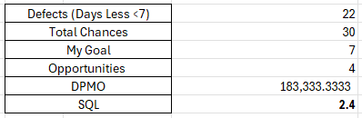

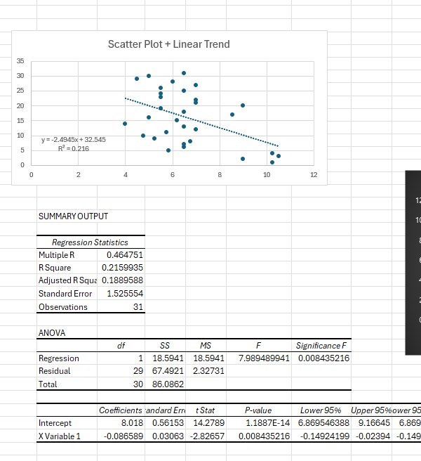

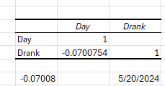
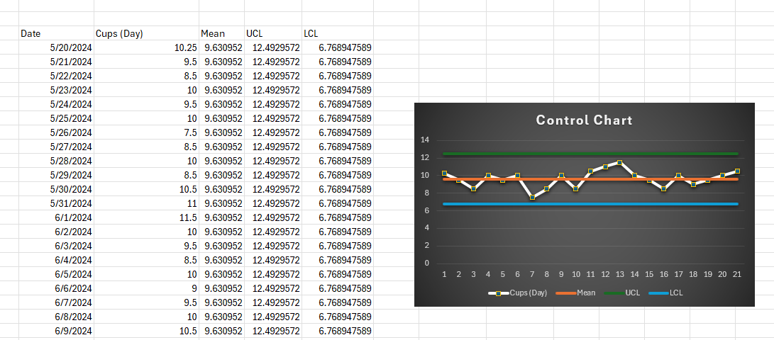

Analyze
The Tools and Items I used to Analyze the Data Where:
Process Map
Descriptive Statistics
SQL (Sigma Quality Level)
Operational Definitions – Slide 3
Data Stratification Tree – Slide 3
Line Chart – Slide 3
Confidence Intervals
Correlation
Simple Linear Regression
Control Charts
SQL (Sigma Quality Level)
I found the linear regression and the correlation to be some of the most important tests done this experience. The correlation, SQL Levels and control chart showed me how to exactly to pin-point where I could improve my processes specifically in the later portions of my weeks to boost my water intake.
The UCL are also important to show me in the future to make a stark difference in my quality I need to push myself beyond the 7 or 10 cups and instead get to about 12 cups of water per day.
SQL Levels
Descriptive Statistics
Process Map
Confidence Intervals for Before and After Analyze
Correlation Between (1-7) Days and Quantity of Water
Control Chart Calculations for Upper and Lower after Analyze
Simple Linear Regressions

Slide 6
Analyze
Before
What is the Data Telling You?
When Analyzing the data we see during the first recorded month that I fail to reach my goal of 7 cups of water 22 times out of the 30 days
I also discovered that most of my heavy consumption days are occurring during the start of the week on Monday, Tuesday and Wednesday
The SQL Before the Changes were 2.4 and the SQL After Changes were 2.7
Control
How Did we Hold Gains?
The best way to Hold the gains of this experiment are to know how it made you feel.
Reported in my earlier documentation, I felt a lot of body aches, headaches and sometimes anger due to lack of proper hydration.
Because of these problems, the increased focused amount of water being taken in has made me feel so much better in terms of mental and physical performance. Those gains are enough to make you want to keep increasing and or hold the current line for water quality and ingestion.
This study I was able to set my original goal at 7 Cups of water per day. The 2nd round data tracking I was able to boost my goal to 10 cups of water and reached that goal over half of the time. I would push myself to continue this experience by bumping 2 more round of tracking at the 12 cups and then doctor recommend 15 cups of water per day.
Improvement
How Did we Improve?
I took Immediate action after reviewing the data from the previous collected month.
I doubled down on the belief of needing more encouragement in regards to trying flavored water or flavor packets.
I also doubled down on the philosophy of trying to stretch out my time of drinking water focusing particularly on the end of the week. I heavily pushed myself to consume more water on days such as Thursday, Friday, Saturday and Sunday.
You can see as evidence on the graphs, tests, correlation and control charts that I was able to greatly increase the amount of water consumed.
I was also able to set my goal to 10 Cups of water and reached that target almost over 50% of the time
After

